Slide 1

Ensemble Techniques
Enhancing Model Performance
Enhancing Model Performance

Slide 2
Ensemble Techniques
Ensemble Learning helps improve machine learning results by combining several models to improve predictive performance compared to a single model.
Definition: Ensemble techniques combine multiple models to improve performance.
Examples: Bagging, Boosting, Stacking.
Purpose: To reduce variance, bias, or improve predictions.

Slide 3
Why Use Ensemble Methods?
Advantages:
Improved accuracy.
Robustness against overfitting.
Better generalization to unseen data.
Disadvantages:
Increased complexity.
Longer training times.

Slide 4
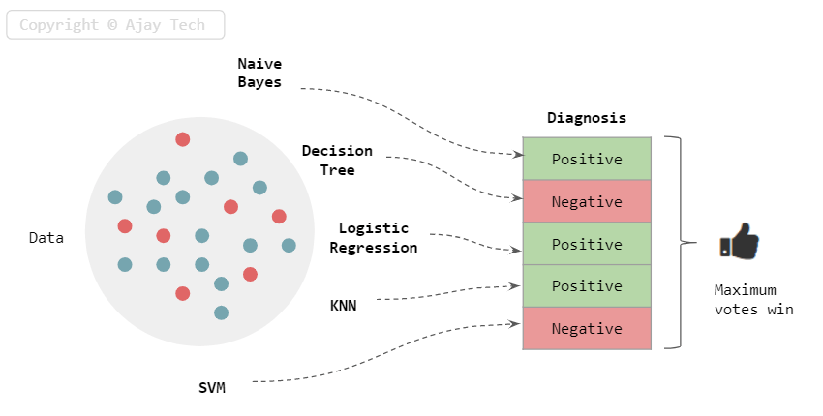
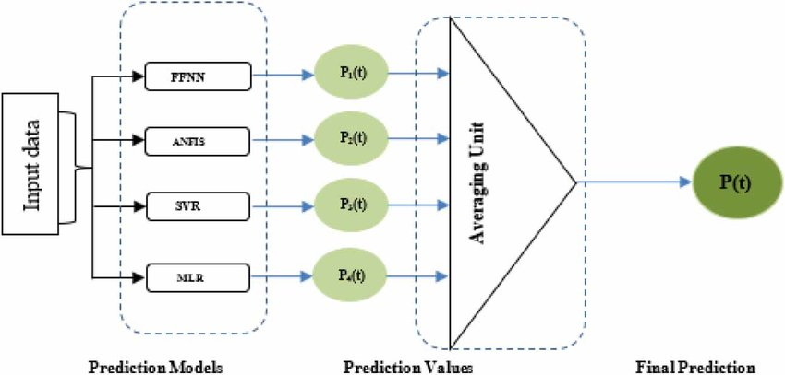
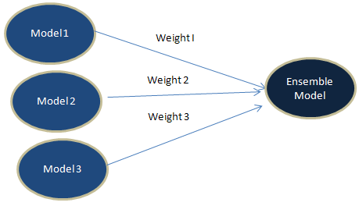
Simple Ensemble Techniques
Max Voting
Averaging
Weighted Average
Advanced Ensemble techniques
Stacking
Blending
Bagging
Boosting
https://www.analyticsvidhya.com/blog/2018/06/comprehensive-guide-for-ensemble-models/

Slide 5
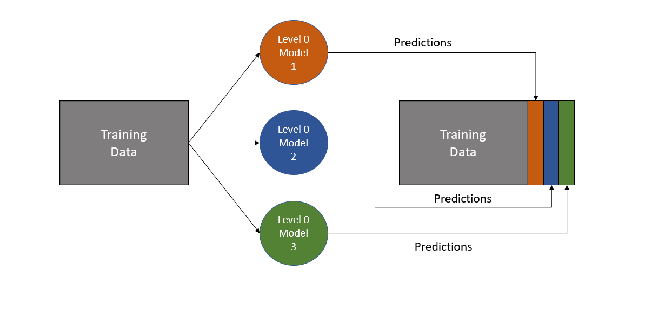
Stacking
Definition: Combines different models (base learners) using another model (meta-learner).
How it Works:
Train multiple different models on the same dataset.
Use their predictions as input features for a higher-level model.
Benefits: Leverages strengths of various algorithms.

Slide 6
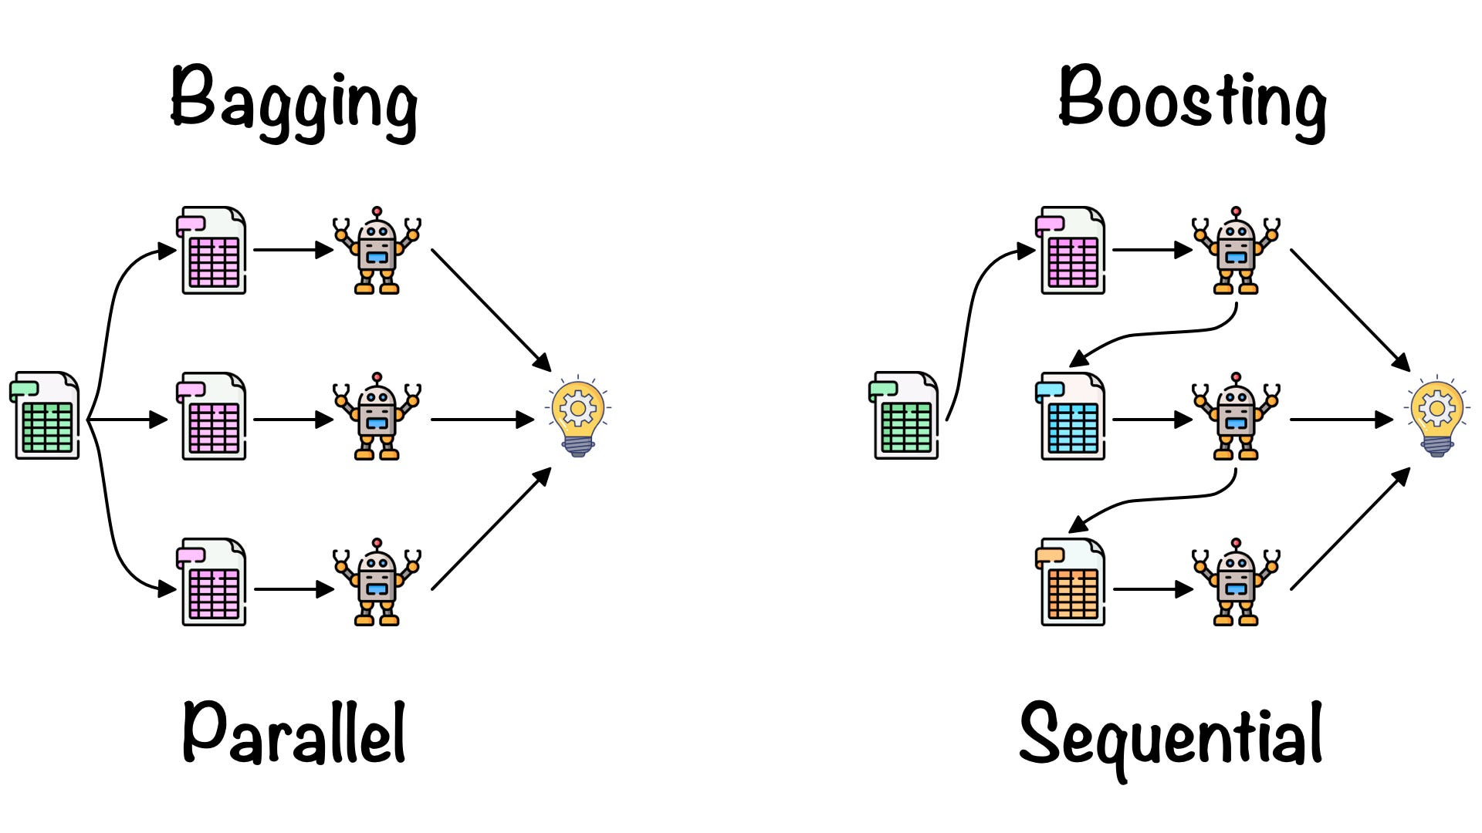
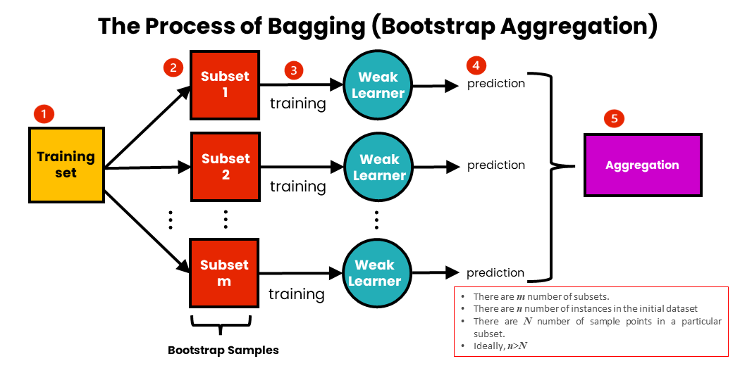
Bagging (Bootstrap Aggregating)
Definition: Reduces variance by training multiple models on random subsets of data.
How it Works:
Create multiple bootstrap samples from the training set.
Train a model (e.g., Decision Trees) on each sample.
Aggregate predictions (e.g., voting for classification, averaging for regression).
Example: Random Forest.

Slide 7
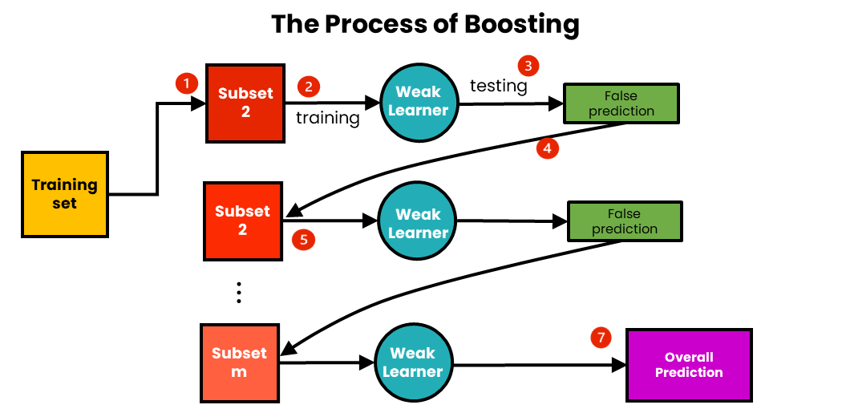
Boosting
Definition: Focuses on correcting the errors of prior models.
How it Works:
Sequentially train models, where each model tries to correct the mistakes of the previous one.
Assign higher weights to misclassified instances.
Combine models using weighted voting or averaging.
Examples: AdaBoost, Gradient Boosting, XGBoost.
Boosting
AdaBoost
Gradient Boosting
XGBoost

Slide 8
Algorithms based on Bagging and Boosting
Bagging meta-estimator
Random Forest
AdaBoost
Gradient Boosting (GBM)
XGBoost
Light GBM
CatBoost

Slide 9
Boosting
AdaBoost
Gradient Boosting
XGBoost
Introduction to Boosting
Adaptive Boosting
Gradient Boosting
XG Boosting

